Slide 1
A Neural Network Model for Predicting Horseshoe Data
Presented by
Erva Karabulut
Notes:
1

Slide 2
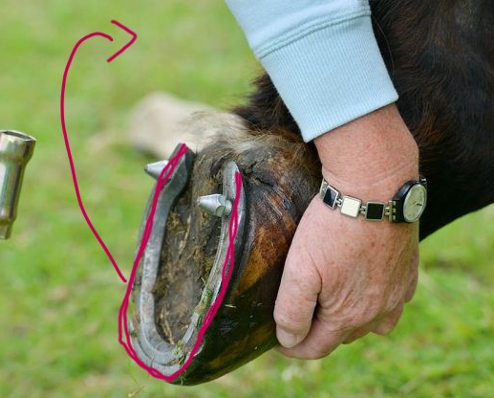
Goal of the project
To predict length of external curve of horseshoe
Finding the best parameters for highest accuracy
External Curve (target)
Notes:
How presentation will benefit audience: Adult learners are more interested in a subject if they know how or why it is important to them.
Presenter’s level of expertise in the subject: Briefly state your credentials in this area, or explain why participants should listen to you.
2

Slide 3
Solution
Neural Network was chosen
  Neural Networks are effective in optimization
MATLAB was used
  For an easier and quicker process
Notes:
Lesson descriptions should be brief.
3

Slide 4
Horseshoe Dataset
4 type of inputs and 1 type of output
219 rows of data
For more accurate results
Normalised inputs between 0 and 1
Notes:
Example objectives
At the end of this lesson, you will be able to:
Save files to the team Web server.
Move files to different locations on the team Web server.
Share files on the team Web server.
4

Slide 5
Methodology
Neural Network Architecture
Inputs
Hidden Layers
Outputs
Method of Training Data
trainlm (Levenberg-Marquardt) and traingd (Gradient Descent) training functions were chosen.
Used a loop to find best combination of:
Notes:
5

Slide 6

Methodology
Used a loop to find best combination of:
Size of first hidden layer
Size of second hidden layer
Training function
Epochs
Learning rate
Notes:
6

Slide 7

Methodology
Used a table to get the results of loops
Used these results for training
Cross Validation to prevent overfitting
“crossvalind” function for cross validation
Notes:
7

Slide 8
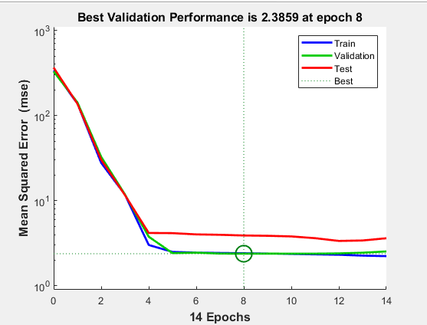
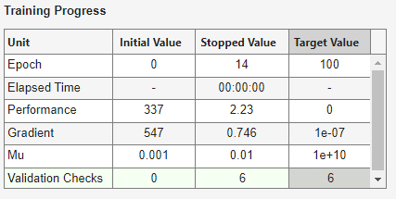
Results
Epoch 8 is the Optimal Point
The Levenberg-Marquardt training function (trainlm) performed best, providing the lowest average validation performance (2.3726)
trainlm performed better than traingd
Notes:
8

Slide 9
Conclusions
The best configuration was found with cross-validation
Limited Range of Hyperparameters due to time limitations
Recommendations
Expand hyperparameter range
Better computational resources
Larger datasets
Notes:
9

